Slide 1
West Nile Virus Prediction
Big problems come in small packages
Members
Mubin
Weihan
Zhenming

Slide 2
Contents
01
02
03
04
What’s the big deal?
Background & Motivations
What do we know?
Data Collection & Exploration
WNV Modelling & Model Interpretation
How much will it cost?
Cost Benefit Analysis
What should we do?
Conclusions & Recommendations

Slide 3
01
What’s the big deal?
Background & Motivations

Slide 4
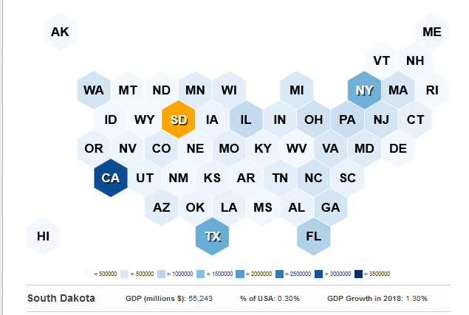
2746 cases / year
Across the United States of America¹
1 in 5
Developed symptoms after being bitten
$56 million/year
In medical treatment and productivity losses ²
Average data from 2005 to 2020. Source: https://www.cdc.gov/westnile/statsmaps/cumMapsData.html#three
Average cost from 1999-2012. Source: https://www.ncbi.nlm.nih.gov/pmc/articles/PMC3945683/
Notes:
https://www.cdc.gov/westnile/statsmaps/cumMapsData.html#three
https://www.ncbi.nlm.nih.gov/pmc/articles/PMC3945683/
https://worldpopulationreview.com/state-rankings/gdp-by-state

Slide 5
Deadly Characteristics
Transmission Mechanism
High Mobility Carriers
Cost of Treatment
Notes:
https://www.cdc.gov/westnile/transmission/index.html

Slide 6
Transmission Mechanism
Infected
Mosquito
Normal
Mosquito
Infected
Mosquito
Population
at Risk
Healthy
Human
Infected
Bird
Infected
Human
Notes:
https://www.cdc.gov/westnile/transmission/index.html

Slide 7
Project Objectives
Estimate the number of mosquitoes in an area
Predict the presence of WNV in an area
Estimate the costs of vector controls
Recommend Time and Place to conduct spraying

Slide 8
02
What do we know?
Data Collection, & EDA

Slide 9


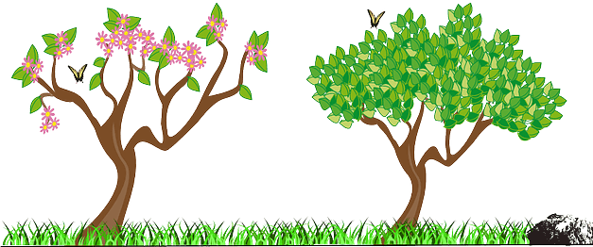
Data Provided
Data Source
Date Range
Traps
Weather
Chicago Department of Public Health
Spring - Summer 2007 - 2014
50-50 split by time for training and validation
136 Mosquito Traps Number of Mosquitoes WNV Presence Sprays Conducted
2 Weather Stations Temperature Wind Direction/Speed Humidity
Notes:
https://www.chicago.gov/content/dam/city/depts/cdph/general/CDPH_HC2025_logo.png
https://encrypted-tbn0.gstatic.com/images?q=tbn:ANd9GcTC6Y5NEEZjPdCQ9mdAwYMiUyqJLi0qRqNdsMoD-b8-gpHS5HT2vMLX_2rnQooGFtiVSQ&usqp=CAU

Slide 10
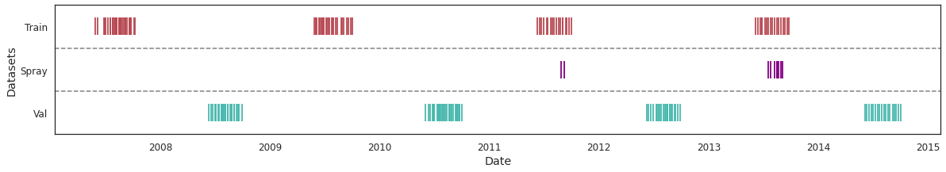
Date Range
Training and Validation data sets are split across alternate years
Spray data was collected for only 2 of 4 years in the training data set

Slide 11
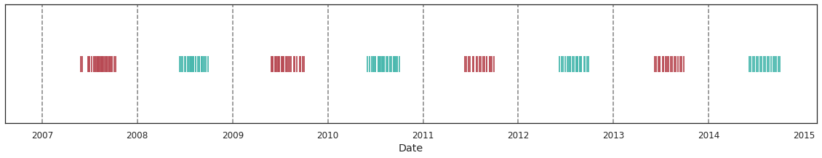
Date Range
Training and Validation data sets are split across alternate years
Spray data was collected for only 2 of 4 years in the training data set

Slide 12
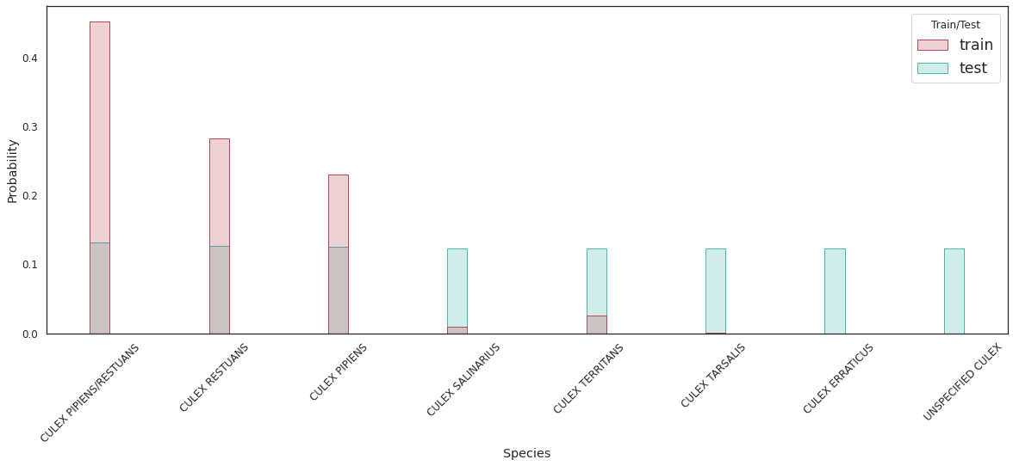
Species Distribution
Only 1 in 100 mosquitos would NOT be CULEX PIPIENS/RESTUANS
CULEX PIPIENS & CULEX RESTUANS account for more than 99.5% of the data set

Slide 13
Species Distribution
Only 1 in 100 mosquitos would NOT be CULEX PIPIENS/RESTUANS
CULEX PIPIENS & CULEX RESTUANS account for more than 99.5% of the data set

Slide 14
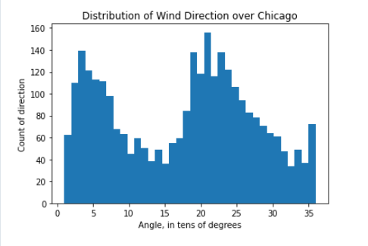
Wind Direction over Chicago
Data provided was rounded off to nearest 10 degrees.
Prevailing winds are from predominantly from the ~20º and ~210º direction.

Slide 15
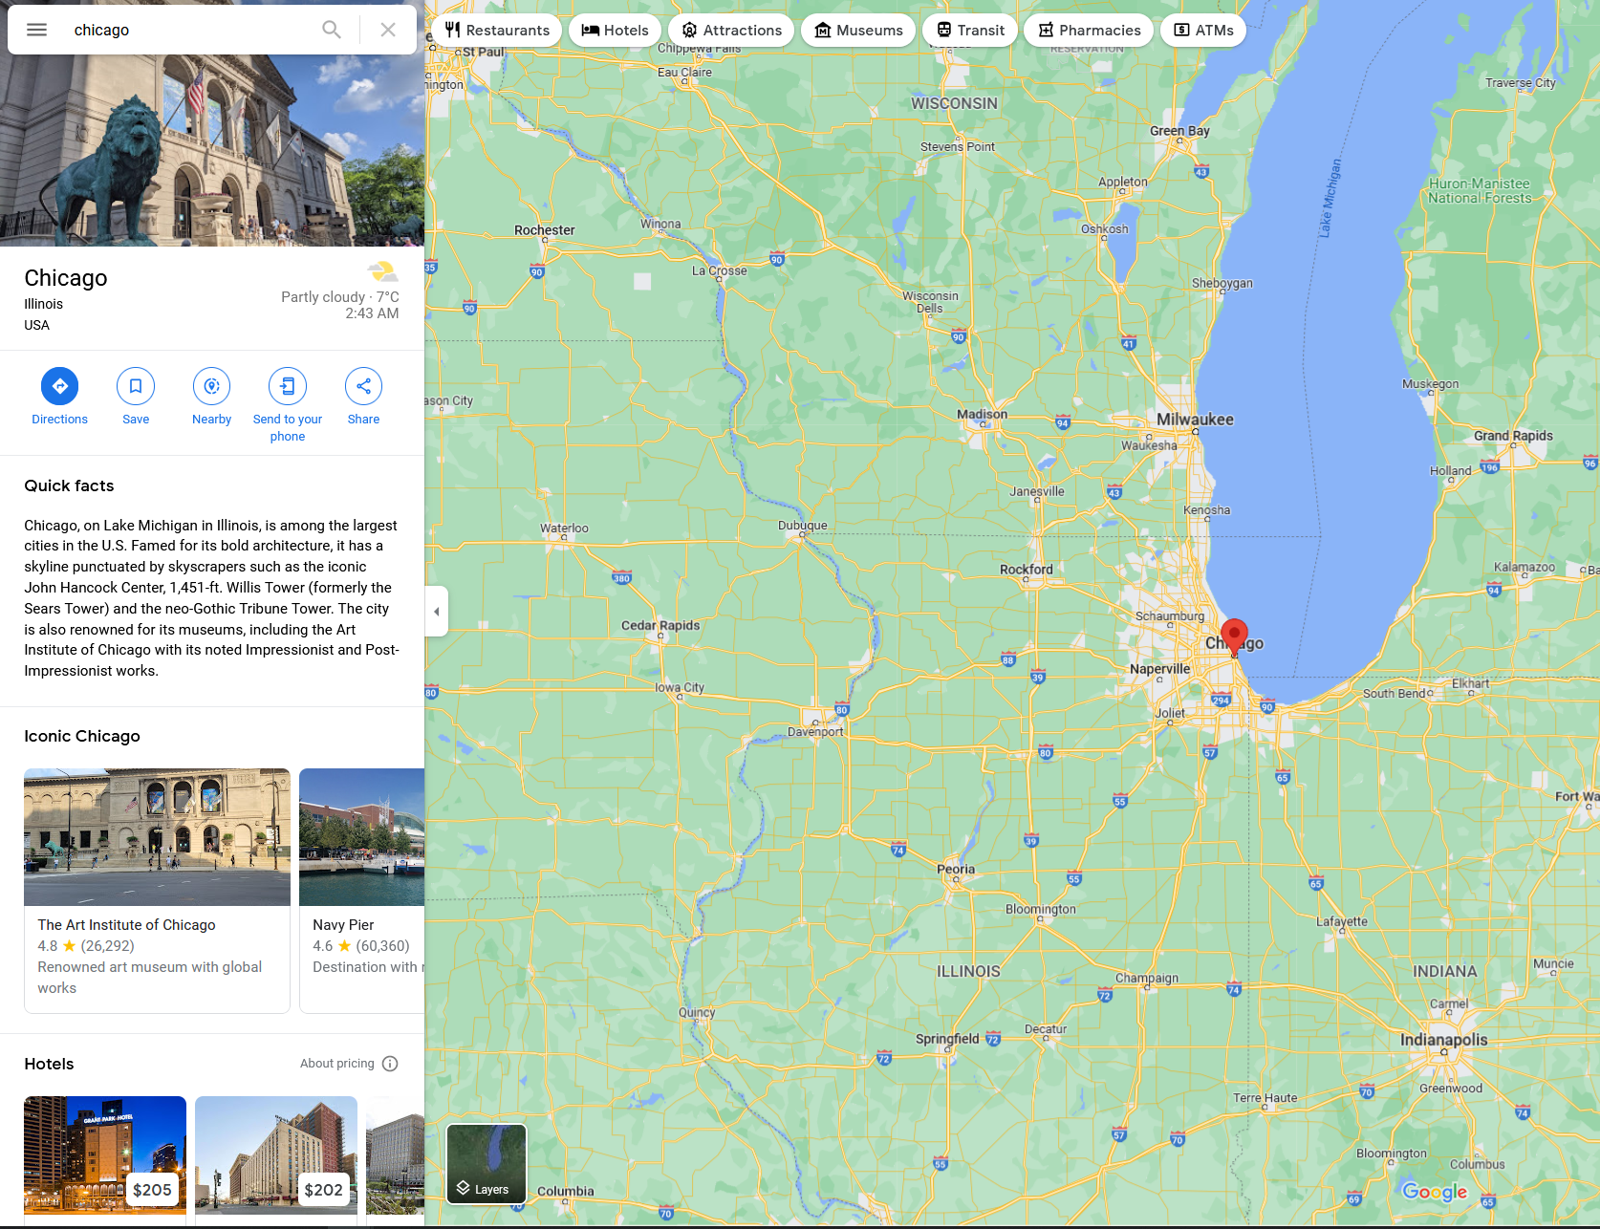

Slide 16
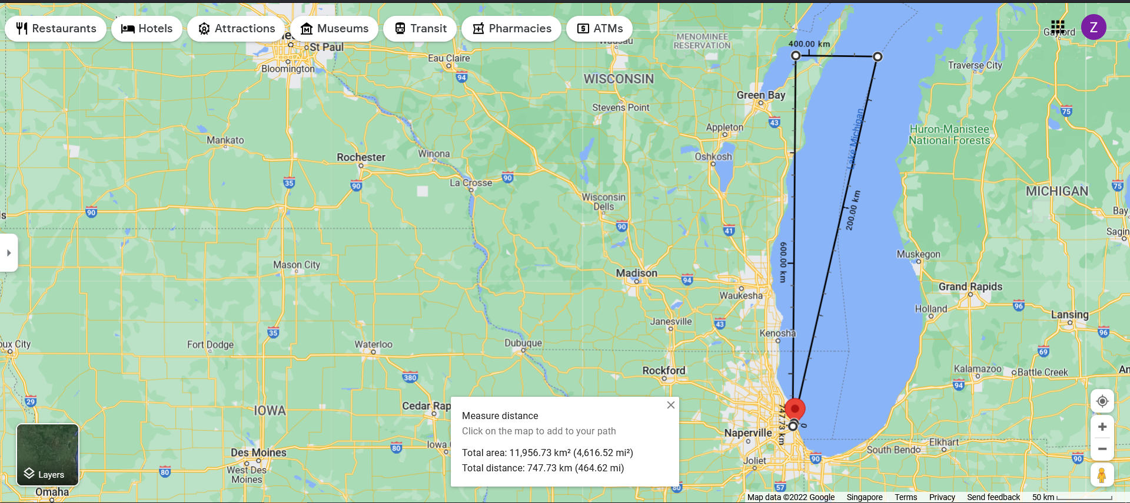
a = 92.52 km
Lake Michigan
cos Ө = (1/2bc) * (b² + c² - a²)
cos Ө = 0.971746
Ө = 13.652º
c = 379.88 km
Ө ?
b = 391.90 km

Slide 17
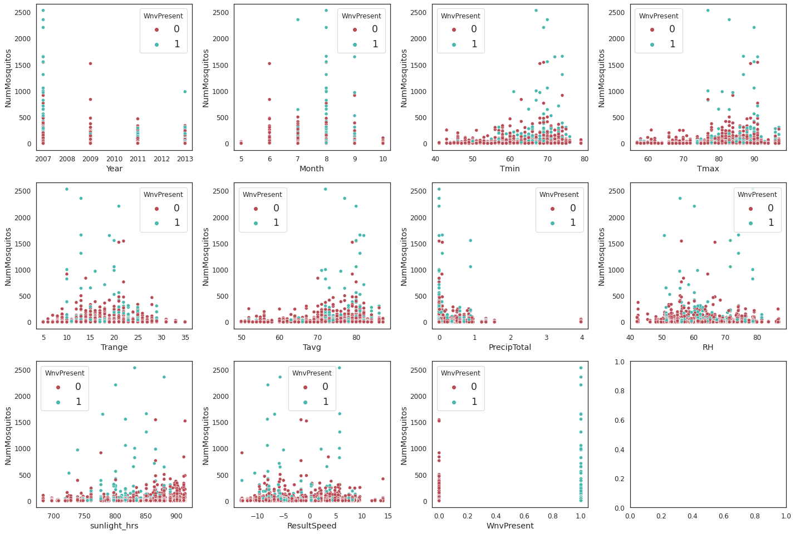
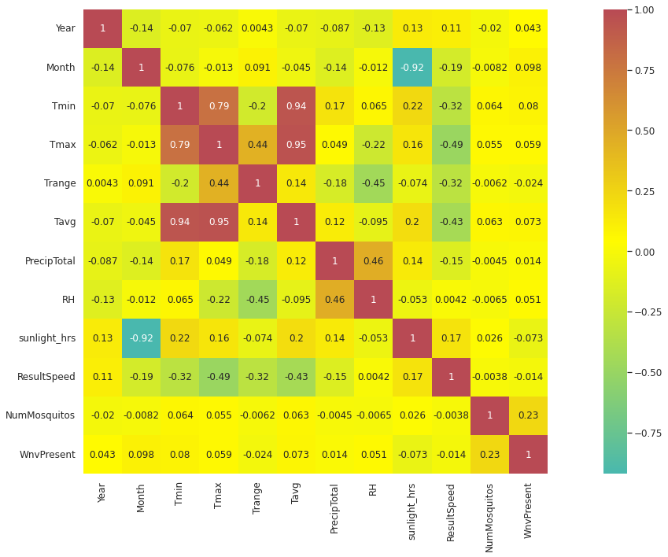
No Strong Linear Correlation with Response

Slide 18
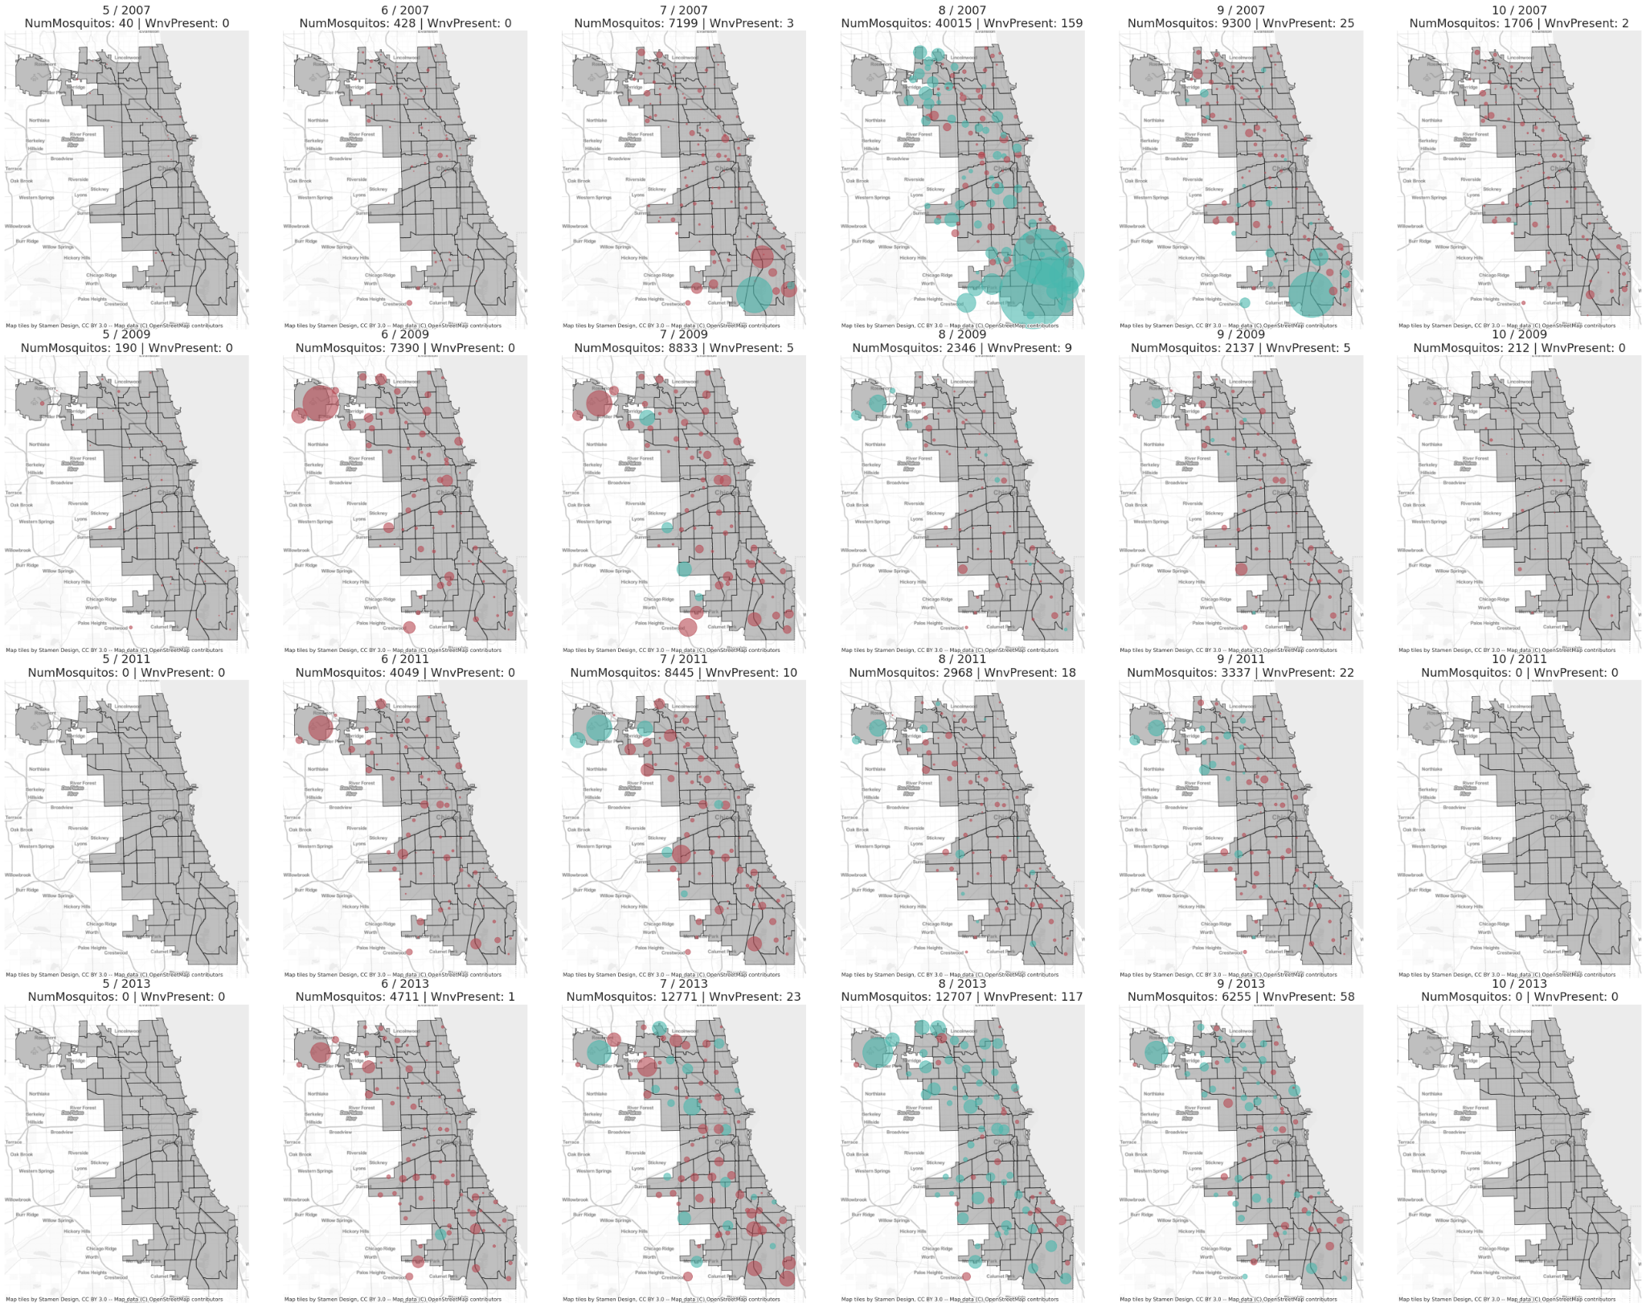
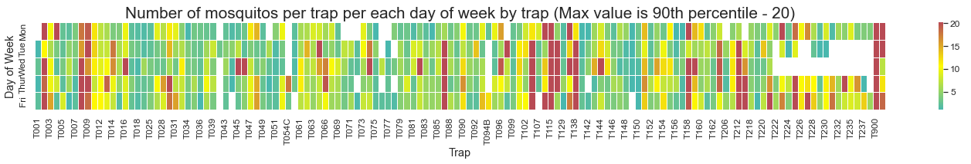
Hotspots
Hotspots tend to result in rapid growth rate of the number of mosquitoes
The high number of mosquitoes puts the area at a higher risk of WNV prevalence
Wnv Present
Size: Higher NumMosquitos
No Wnv

Slide 19
Hotspots
Hotspots tend to result in rapid growth rate of the number of mosquitoes
The high number of mosquitoes puts the area at a higher risk of WNV prevalence
Wnv Present
Size: Higher NumMosquitos
No Wnv

Slide 20
02
What do we know?
Feature Engineering & Data Modelling

Slide 21




Feature Engineering
Wind Direction
One-Hot-Encode
Species Aggregation
Resolving wind direction towards Lake Michigan
One hot encoding of categorical features
Aggregating based on Culex Pipen/Restuans
Lag Weather
Distance Matrix
Data Withholding
Lagging weather observations by 5 to 14 days
Inverse weighted distance from neighbouring traps
40-10-50 split of
train-test-validation

Slide 22
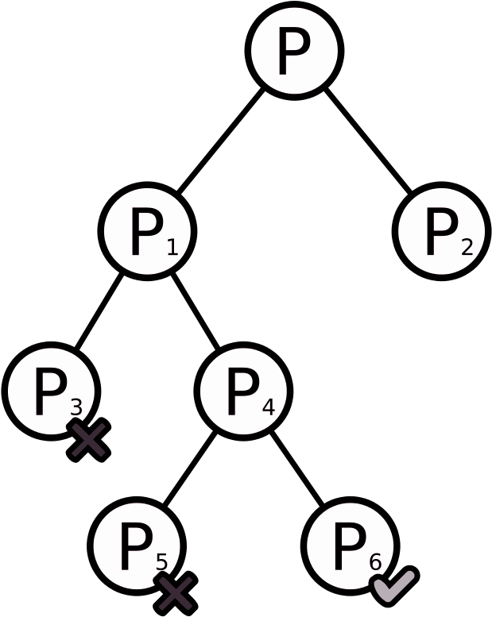
Modelling Approach
Data Preprocessing
Regression Modelling
Classification Modelling
To obtain NumMosquitos
To determine Wnv Presence

Slide 23
Preprocessing
Species Balancing
Oversampling
Cross validation
Add rows for unfound species
Oversampling on minority response class using SMOTE
5-fold Cross-validation on training set
PCA
Scaling
Conduct PCA for linear models
Either Standard Scaling or MinMax Scaling

Slide 24
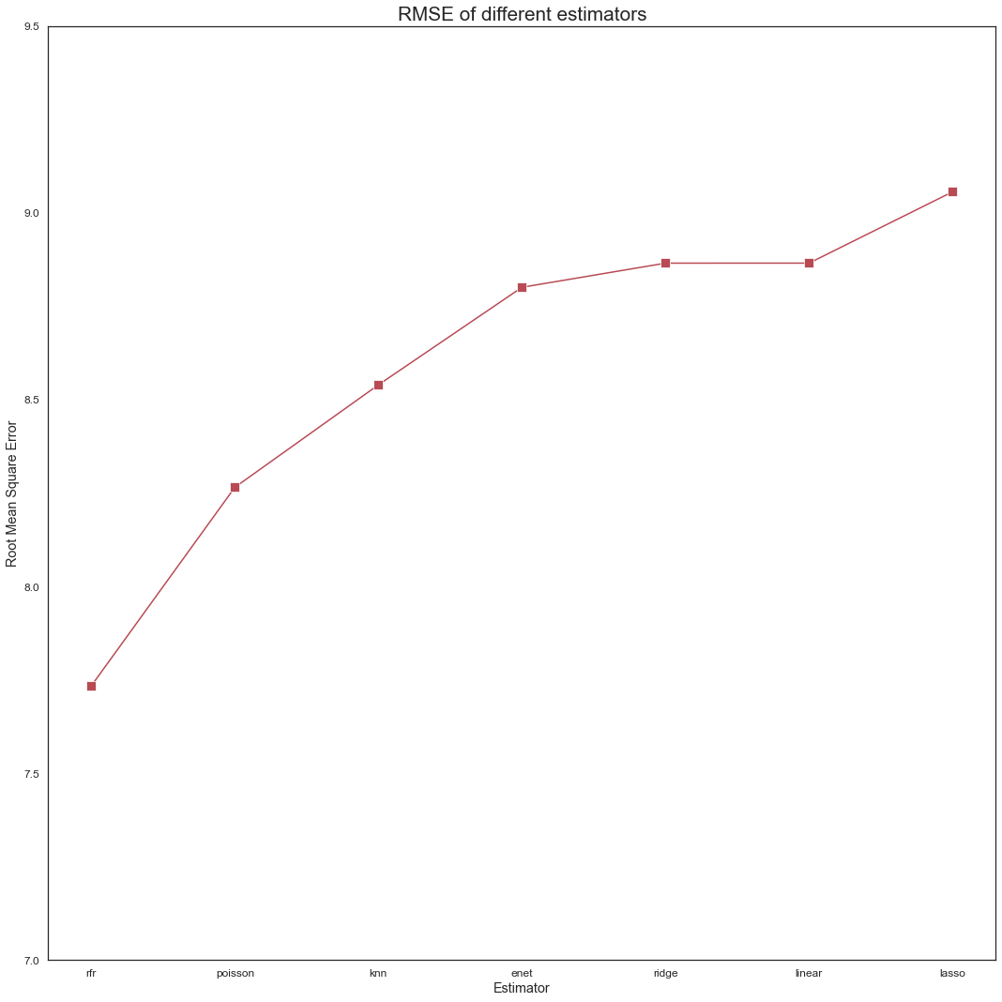
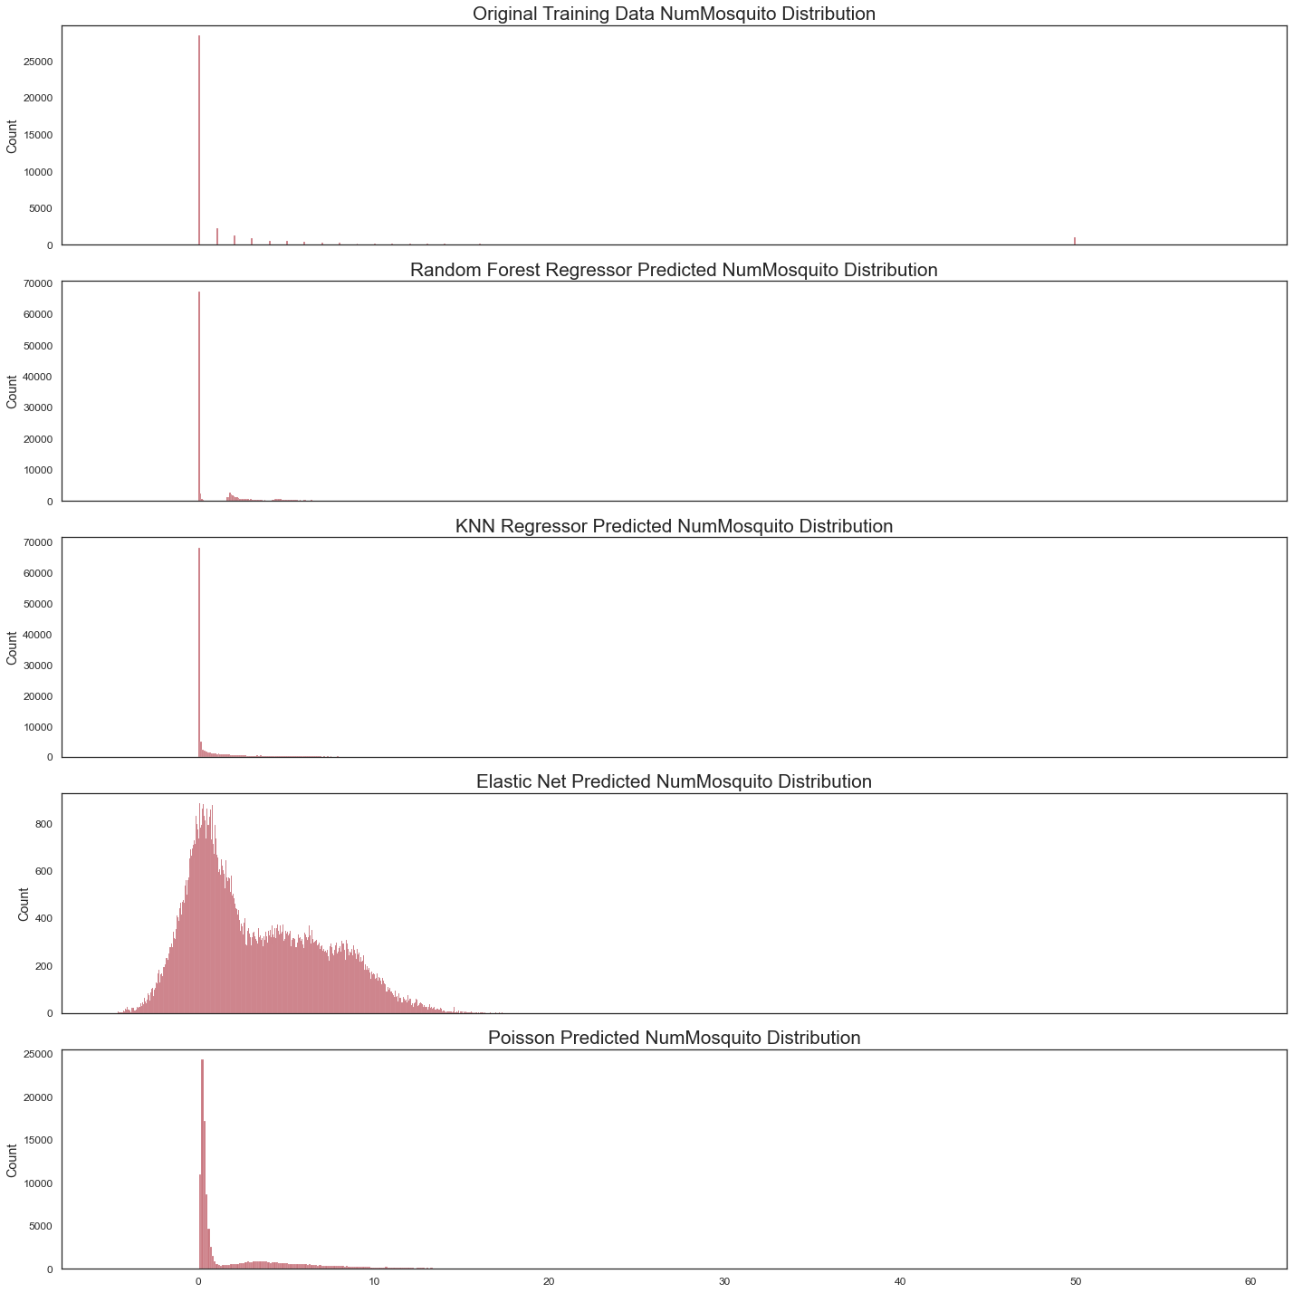
Model Performance (Regression)
Chosen Model: Random Forest Regressor

Slide 25
Model Performance (Classification)
Cross Validated Scores
Model | ROC-AUC | Accuracy | Recall | Precision
Gradient Boosting | 0.93 | 0.93 | 0.55 | 0.13
Random Forest | 0.91 | 0.93 | 0.70 | 0.14
Logistics Regression | 0.77 | 0.88 | 0.52 | 0.07
Notes:
Will add in confusion matrix later
Precision = TP / (TP+FP)
Recall = TP / (TP+FN)

Slide 26
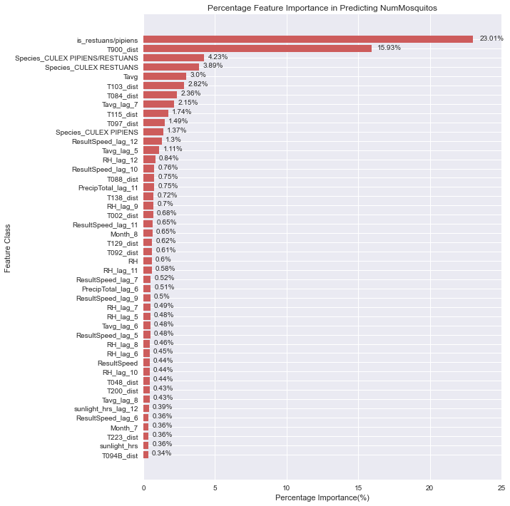
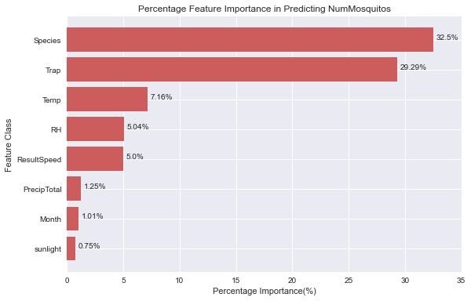
Feature Importance: NumMosquitos
Species type (32.5%)
Pipiens / Restuans
Trap location (29.3%)
Weather Data (18.5%)
Temperature
Humidity
Wind Speed/Direction
Total Rainfall
Three categories sum to >80%

Slide 27
Feature Importance: NumMosquitos

Slide 28
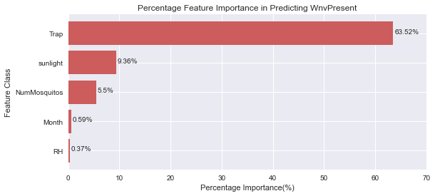
Feature Importance: WnvPresent
Trap location (63.52%)
Sunlight hours (9.36%)
NumMosquitos (5.5%)
Month Number (0.59%)

Slide 29
Feature Importance: WnvPresent

Slide 30
03
How much will it cost?
Cost Benefit Analysis

Slide 31
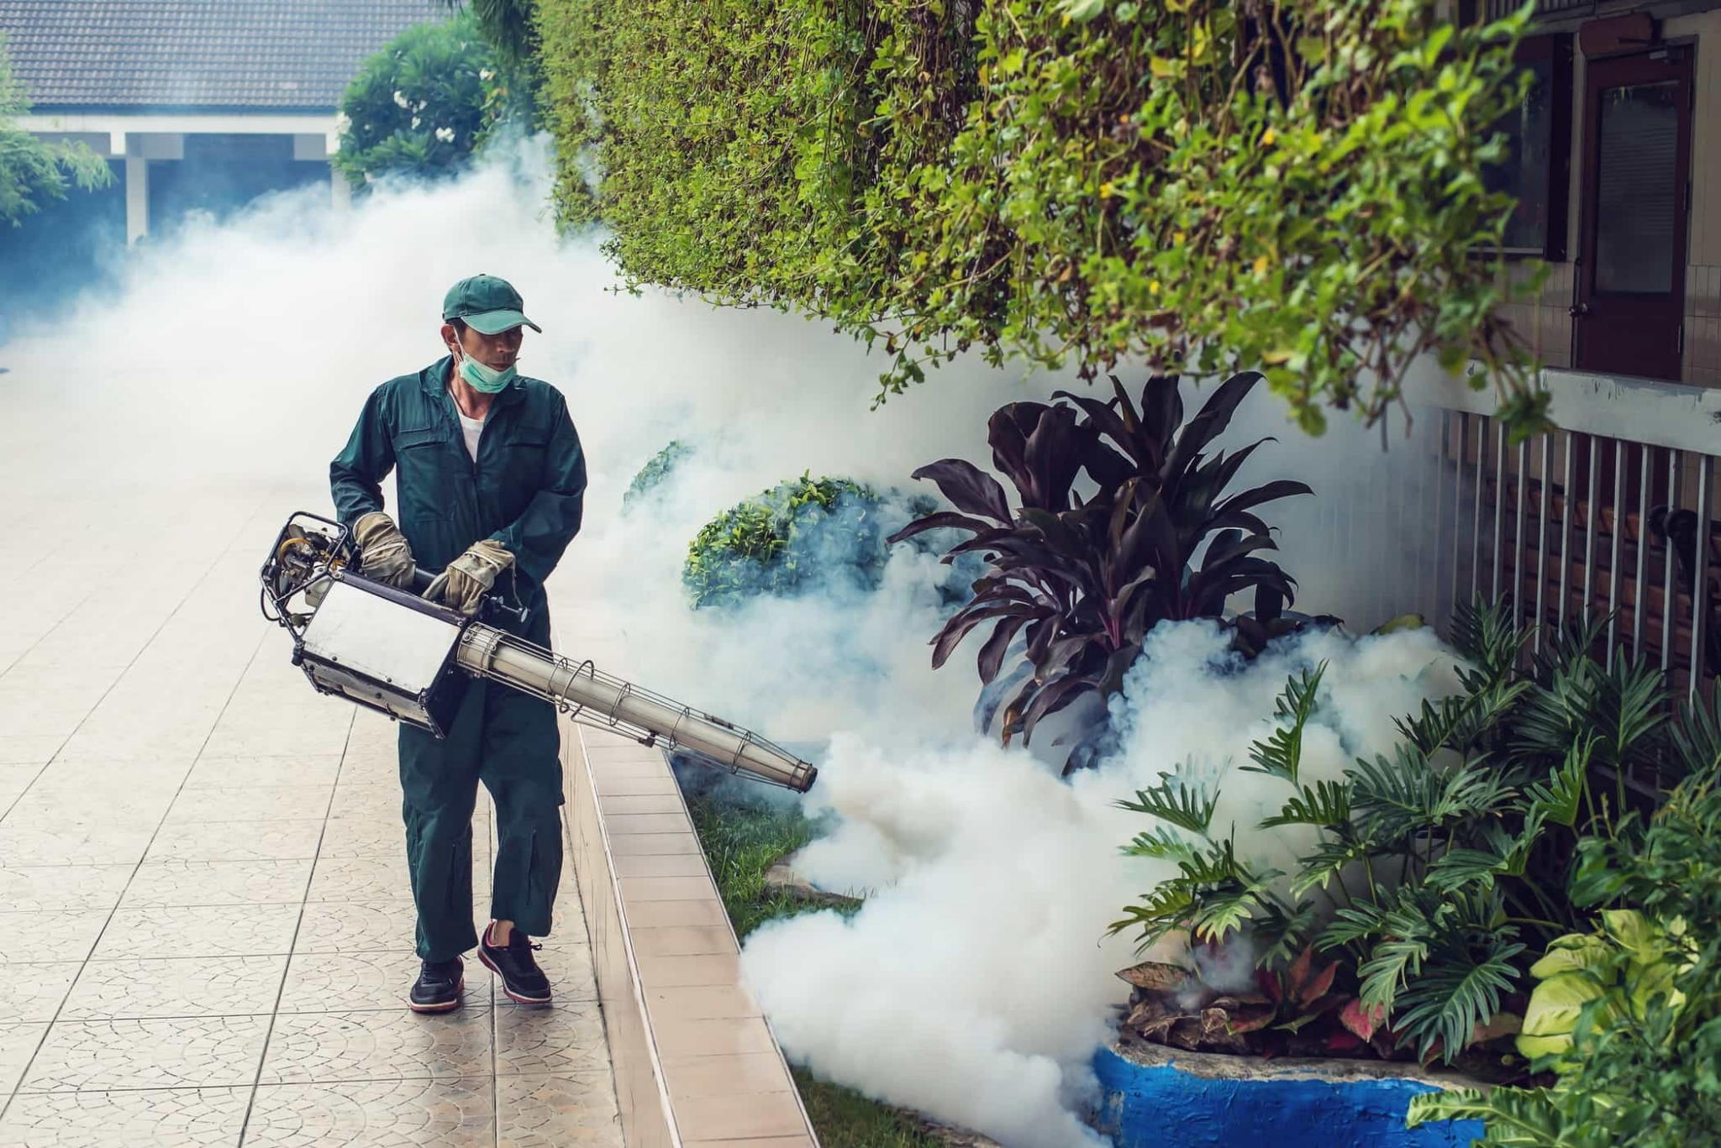

Primary Cost Drivers
Spraying
Healthcare & Productivity
Cost associated with conducting vector controls
Costs associated with medical coverage & productivity losses
Notes:
https://www.kamalandkamal.com/wp-content/uploads/2018/07/ThinkstockPhotos-637544612.jpg
http://res.heraldm.com/content/image/2021/11/25/20211125000713_0.jpg

Slide 32
Spray Cost Model
f | Frequency | Number of sprays in a given period
A | Area | Area covered
UC_{s} | Unit Cost | Cost per spray
Spray Costs
C_{S} = f x A x UC_{s}
Cost associated with conducting vector controls
Notes:
https://www.kamalandkamal.com/wp-content/uploads/2018/07/ThinkstockPhotos-637544612.jpg
http://res.heraldm.com/content/image/2021/11/25/20211125000713_0.jpg

Slide 33
Healthcare Cost Model
N_{M} | NumMos | Number of mosquitoes trapped
T | %Trapped | Percentage of mosquitoes trapped
N_{B} | NumBites | Number of human bites, per mosquito
V | WnvPresent | Binary toggle; Indicates if WNV is detected in mosquitoes trapped
UC_{H} | Unit Cost | Averaged healthcare and productivity costs, per person
Healthcare &
Productivity Costs
C_{H} = (N_{M} x T) x (N_{B} x V) x UC_{H}
C_{H} =
Mosquito Population
x
Human Infection Rate
x
Per Head Cost
Costs associated with medical coverage & productivity losses
Notes:
https://www.kamalandkamal.com/wp-content/uploads/2018/07/ThinkstockPhotos-637544612.jpg
http://res.heraldm.com/content/image/2021/11/25/20211125000713_0.jpg

Slide 34
Cost Optimization
Costs
Linear increase with each spray
Spray Costs, C_{s}
Spray Frequency

Slide 35
Cost Optimization
Costs
Diminishing returns on healthcare savings
Healthcare Costs, C_{H}
Linear increase with each spray
Spray Costs, C_{s}
Spray Costs, C_{s}
Spray Frequency

Slide 36
Cost Optimization
Identify Optimal Costs
Costs
Total Costs, C_{s} + C_{H}
Diminishing returns on healthcare savings
Healthcare Costs, C_{H}
Linear increase with each spray
Spray Costs, C_{s}
Spray Costs, C_{s}
Spray Frequency

Slide 37
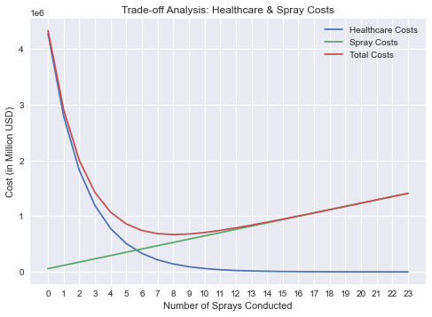
Simulation Results
Min Total Costs | $669,321
Optimal Spray Freq | 9 sprays
Healthcare Costs: $6,317 USD per person
%Population Infected: 0.1% (1,000 per million)
Spray Costs: $0.92 / acre
%Infected Reduction: 65.3%
Notes:
https://www.terminix.com/mosquitoes/facts/how-long-do-mosquitoes-live/
https://www.westernexterminator.com/mosquitoes/mosquito-bite-facts-and-tips/
https://www.aimspress.com/fileOther/PDF/MBE/1551-0018_2016_2_401.pdf

Slide 38
Simulation Results
Min Total Costs | $669,321
Optimal Spray Freq | 9 sprays
Healthcare Costs: $6,317 USD per person
%Population Infected: 0.1% (1,000 per million)
Spray Costs: $0.92 / acre
%Infected Reduction: 65.3%
Notes:
https://www.terminix.com/mosquitoes/facts/how-long-do-mosquitoes-live/
https://www.westernexterminator.com/mosquitoes/mosquito-bite-facts-and-tips/
https://www.aimspress.com/fileOther/PDF/MBE/1551-0018_2016_2_401.pdf

Slide 39
04
What should we do?
Conclusions & Recommendations
Notes:
https://www.kamalandkamal.com/wp-content/uploads/2018/07/ThinkstockPhotos-637544612.jpg

Slide 40
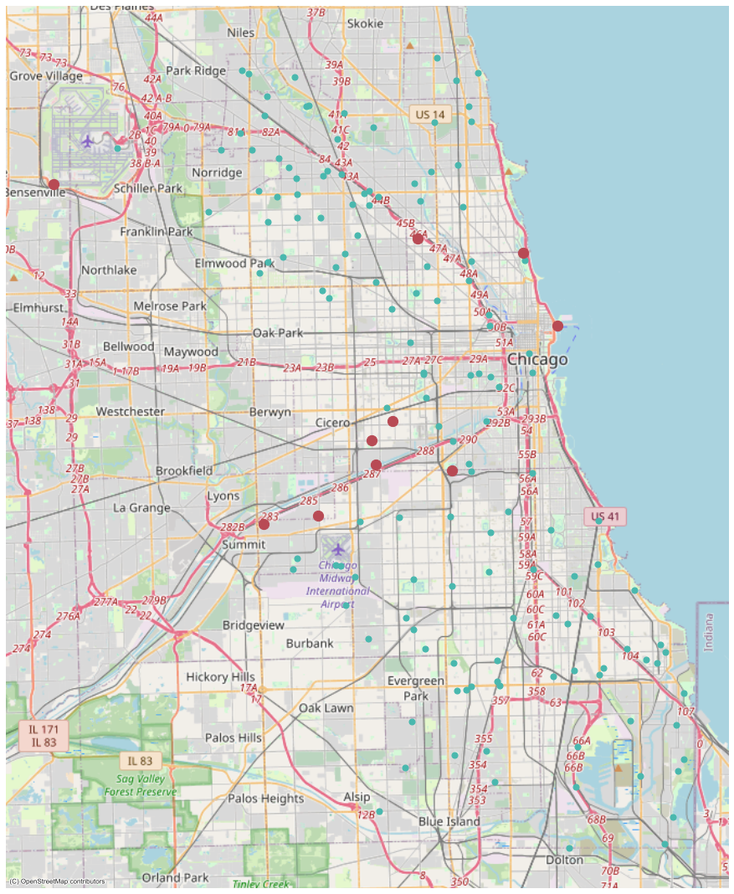

Conclusions
High Risk in July-Sept
Hotspots Identified
Consistently High Wnv Occurrence in these months
Traps were ranked based on relative importance

Slide 41

Recommendations
Preventive
Sprays
Increased Surveillance
Aggressive spraying in earlier months
Increasing surveillance near hotspots

Slide 42
Location of
Critical Monitoring Traps
Notes:
Animate to reveal each cost
Use swipe right animation

Slide 43
Thanks
Do you have any questions?

Slide 44
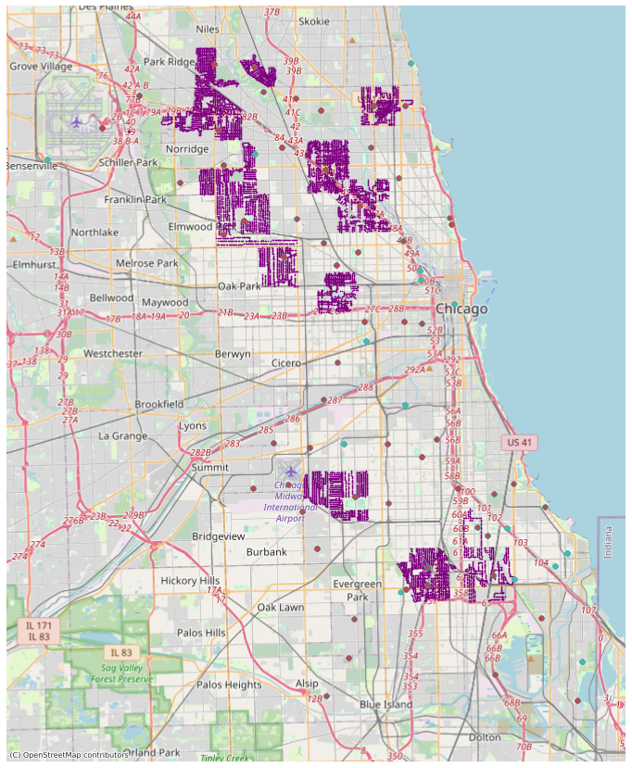
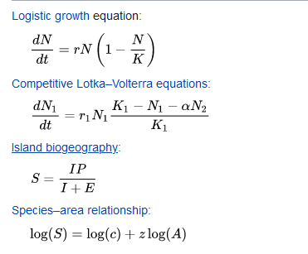
Future
Improvements
From the plots, we visually see that the spray areas are concentrated in distinct clusters
Incorporate Local Population as inputs
Has a key role in outbreak mechanisms
Incorporate Bird Population & Migratory Paths
Leverage robust population modelling techniques
Notes:
Animate to reveal each cost
Use swipe right animation

Slide 45
Cost Optimization
Costs
Identify Optimal Costs
Total Costs, C_{s} + C_{H}
Spray Costs, C_{s}
Linear increase with each spray
Diminishing returns on healthcare savings
Healthcare Costs, C_{H}
Spray Frequency
Notes:
Animate to reveal each cost
Use swipe right animation

Slide 46
a = 92.52 km
cos Ө = (1/2bc) * (b² + c² - a²)
cos Ө = 0.971746
Ө = 13.652º
c = 379.88 km
Ө ?
b = 391.90 km

Slide 47
Fonts & colors used
This presentation has been made using the following fonts:
Chivo
(https://fonts.google.com/specimen/Chivo)
Catamaran
(https://fonts.google.com/specimen/Catamaran)
#443440
#5c4f58
#5d3742
#8c8184
#76515b
#7f434e
#b84a54
#cfe2f3
#ffffff

